Slide 1



Lecture Slides
Chapter 2
Materials
© 2015 by McGraw-Hill Education. This is proprietary material solely for authorized instructor use. Not authorized for sale or distribution in any manner. This document may not be copied, scanned, duplicated, forwarded, distributed, or posted on a website, in whole or part.

Slide 2
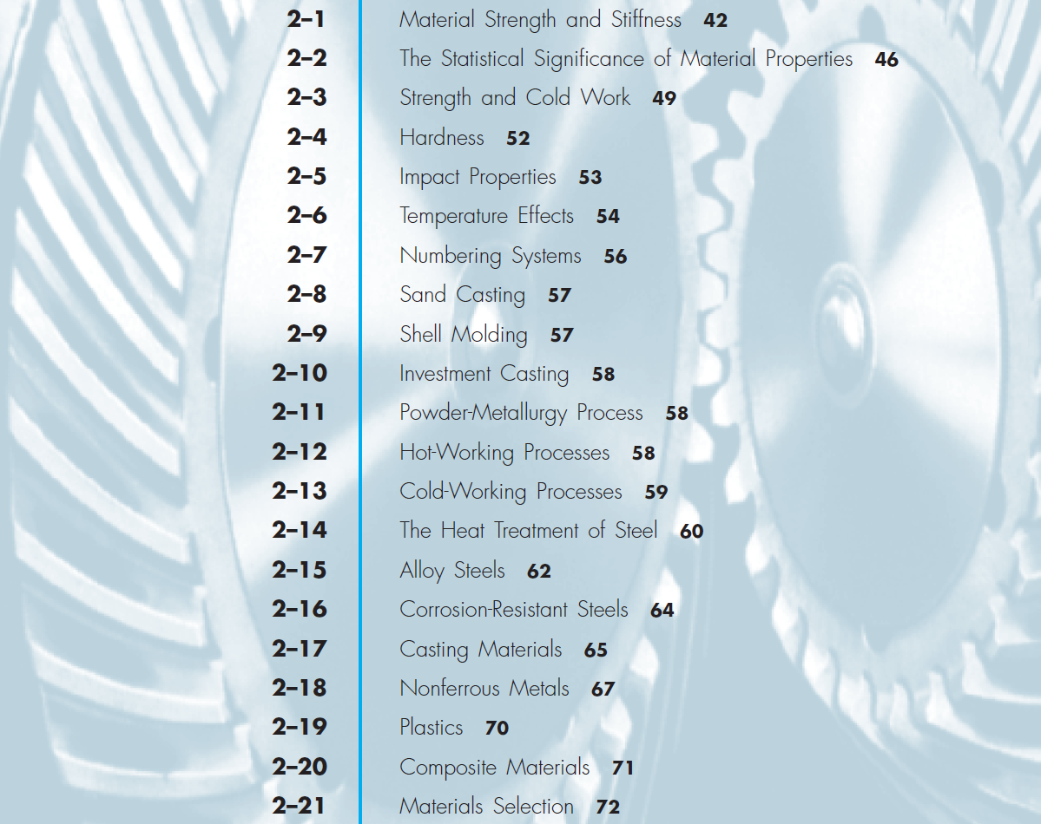
Chapter Outline

Slide 3
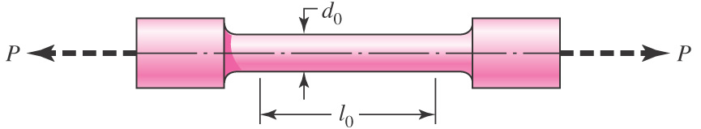
Standard Tensile Test
Fig. 2–1
Used to obtain material characteristics and strengths
Loaded in tension with slowly increasing P
Load and deflection are recorded

Slide 4
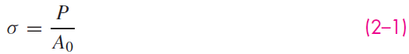
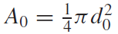
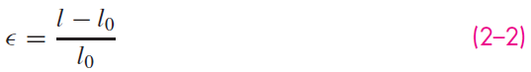
Stress and Strain
The stress is calculated from
where
is the original cross-sectional area.
The normal strain is calculated from
where l₀ is the original gauge length and l is the current length corresponding to the current P.

Slide 5
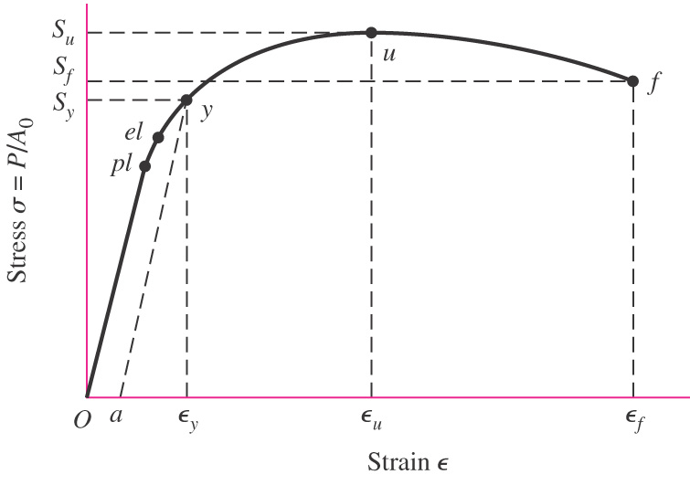
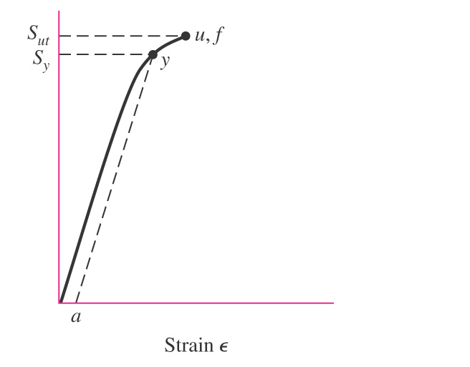
Stress-Strain Diagram
Plot stress vs. normal strain
Typically linear relation until the proportional limit, pl
No permanent deformation until the elastic limit, el
Yield strength, S_{y} , defined at point where significant plastic deformation begins, or where permanent set reaches a fixed amount, usually 0.2% of the original gauge length
Ultimate strength, S_{u} , defined as the maximum stress on the diagram
Ductile material
Brittle material
Fig. 2–2

Slide 6
Elastic Relationship of Stress and Strain
Slope of linear section is Young’s Modulus, or modulus of elasticity, E
Hooke’s law
E is relatively constant for a given type of material (e.g. steel, copper, aluminum)
See Table A–5 for typical values
Usually independent of heat treatment, carbon content, or alloying
Fig. 2–2 (a)

Slide 7

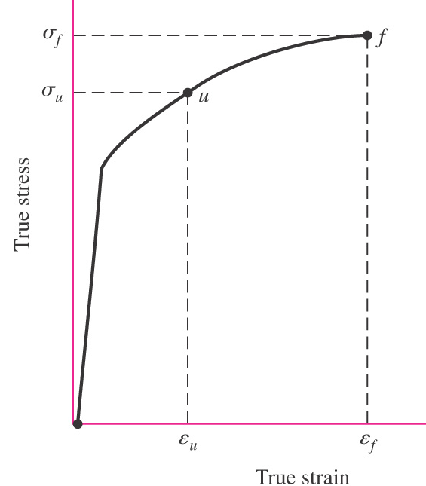
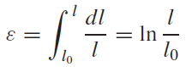
True Stress-Strain Diagram
Engineering stress-strain diagrams (commonly used) are based on original area.
Area typically reduces under load, particularly during “necking” after point u.
True stress is based on actual area corresponding to current P.
True strain is the sum of the incremental elongations divided by the current gauge length at load P.
Note that true stress continually increases all the way to fracture.
Engineering stress-strain
True Stress-strain
(2–4)

Slide 8
Compression Strength
Compression tests are used to obtain compressive strengths.
Buckling and bulging can be problematic.
For ductile materials, compressive strengths are usually about the same as tensile strengths, S_{uc} = S_{ut} .
For brittle materials, compressive strengths, S_{uc} , are often greater than tensile strengths, S_{ut} .

Slide 9
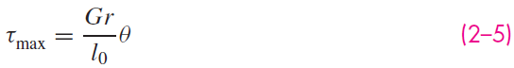
Torsional Strengths
Torsional strengths are found by twisting solid circular bars.
Results are plotted as a torque-twist diagram.
Shear stresses in the specimen are linear with respect to the radial location – zero at the center and maximum at the outer radius.
Maximum shear stress is related to the angle of twist by
θ is the angle of twist (in radians)
r is the radius of the bar
l₀ is the gauge length
G is the material stiffness property called the shear modulus or modulus of rigidity.

Slide 10
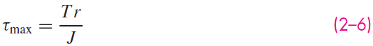
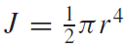
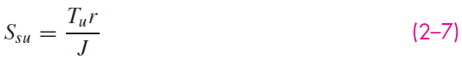
Torsional Strengths
Maximum shear stress is related to the applied torque by
J is the polar second moment of area of the cross section
For round cross section,
Torsional yield strength, S_{sy} corresponds to the maximum shear stress at the point where the torque-twist diagram becomes significantly non-linear
Modulus of rupture, S_{su} corresponds to the torque T_{u} at the maximum point on the torque-twist diagram

Slide 11
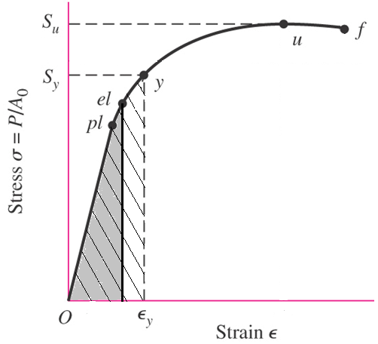
Resilience
Resilience – Capacity of a material to absorb energy within its elastic range
Modulus of resilience, u_{R}
Energy absorbed per unit volume without permanent deformation
Equals the area under the stress-strain curve up to the elastic limit
Elastic limit often approximated by yield point

Slide 12
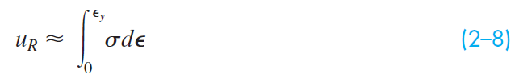
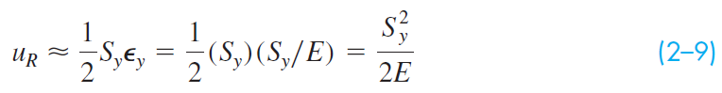
Resilience
Area under curve to yield point gives approximation
If elastic region is linear,
For two materials with the same yield strength, the less stiff material (lower E) has greater resilience

Slide 13
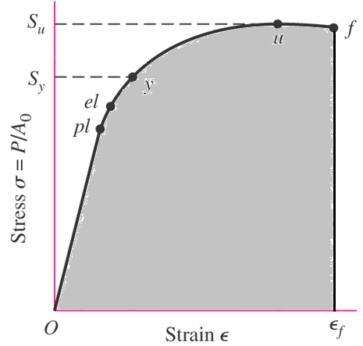
Toughness
Toughness – capacity of a material to absorb energy without fracture
Modulus of toughness, u_{T}
Energy absorbed per unit volume without fracture
Equals area under the stress-strain curve up to the fracture point

Slide 14
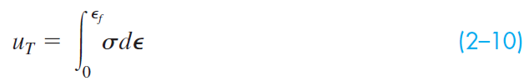
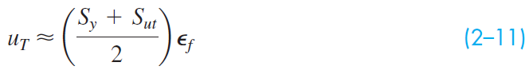
Toughness
Area under curve up to fracture point
Often estimated graphically from stress-strain data
Approximated by using the average of yield and ultimate strengths and the strain at fracture

Slide 15
Resilience and Toughness
Measures of energy absorbing characteristics of a material
Units are energy per unit volume
lbf·in/in³ or J/m³
Assumes low strain rates
For higher strain rates, use impact methods (See Sec. 2–5)

Slide 16
Statistical Significance of Material Properties
Strength values are obtained from testing many nominally identical specimens
Strength, a material property, is distributional and thus statistical in nature

Slide 17
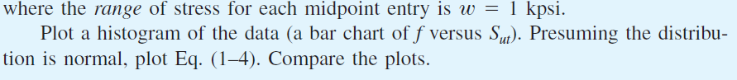
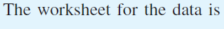
Example 2-1
Solution

Slide 18
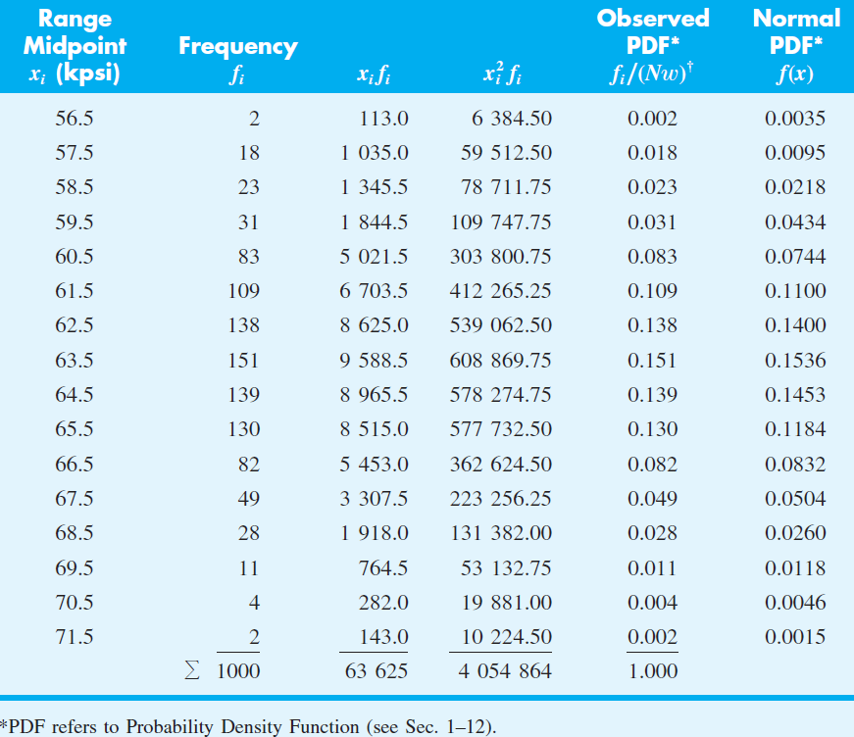
Example 2-1

Slide 19
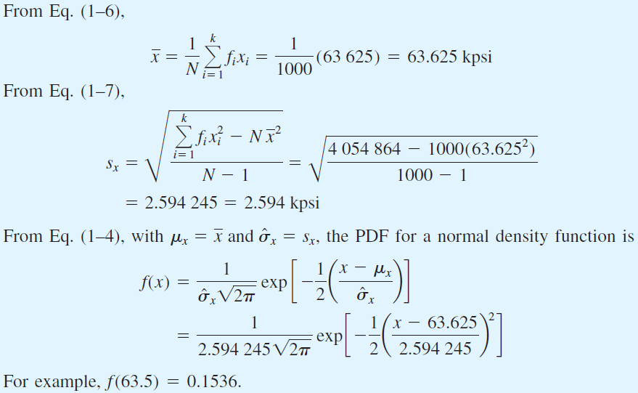
Example 2-1

Slide 20
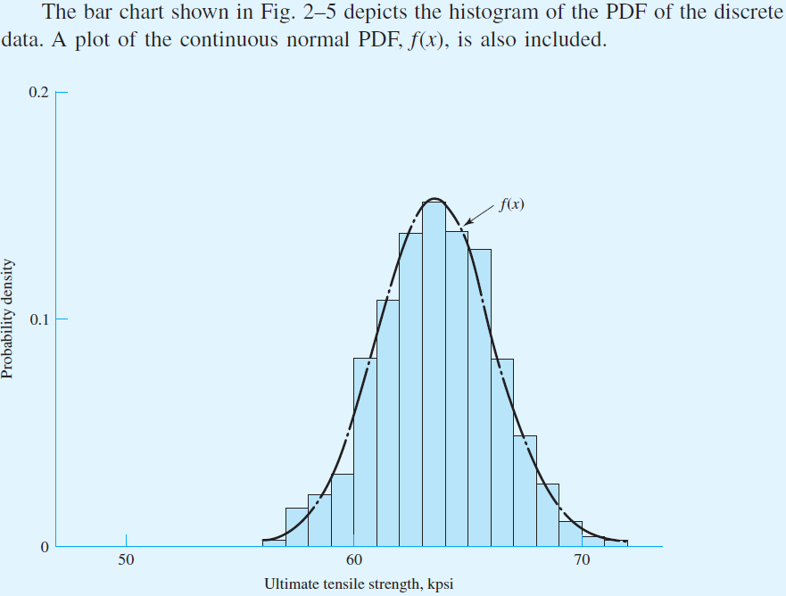
Example 2-1
Fig. 2–5

Slide 21
Strengths from Tables
Property tables often only report a single value for a strength term
Important to check if it is mean, minimum, or some percentile
Common to use 99% minimum strength, indicating 99% of the samples exceed the reported value

Slide 22
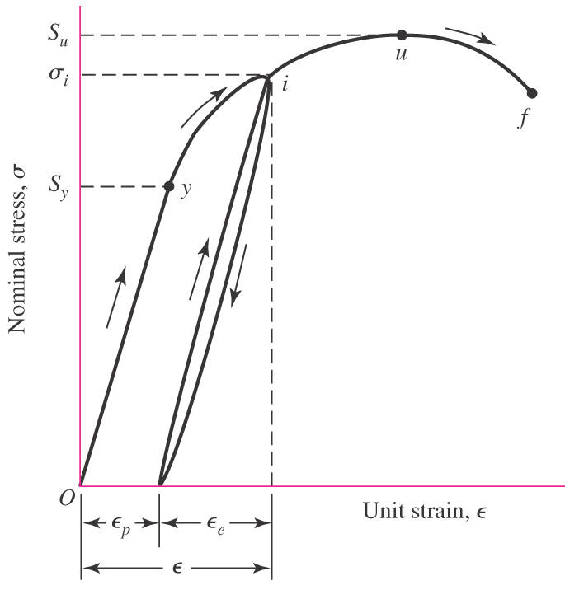
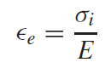
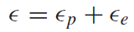
Cold Work
Cold work – Process of plastic straining below recrystallization temperature in the plastic region of the stress-strain diagram
Loading to point i beyond the yield point, then unloading, causes permanent plastic deformation, ϵ_{p}
Reloading to point i behaves elastically all the way to i, with additional elastic strain ϵ_{e}
Fig. 2–6 (a)

Slide 23
Cold Work
The yield point is effectively increased to point i
Material is said to have been cold worked, or strain hardened
Material is less ductile (more brittle) since the plastic zone between yield strength and ultimate strength is reduced
Repeated strain hardening can lead to brittle failure
Fig. 2–6 (a)

Slide 24
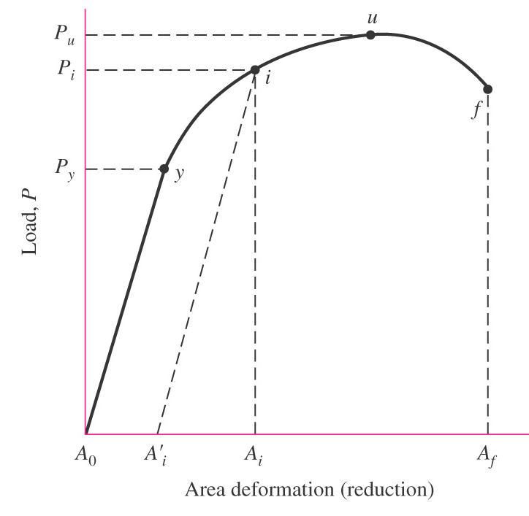
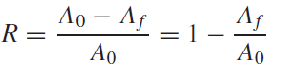
Reduction in Area
Plot load P vs. Area Reduction
Reduction in area corresponding to load P_{f} at fracture is
R is a measure of ductility
Ductility represents the ability of a material to absorb overloads and to be cold-worked
(2–12)
Fig. 2–6 (b)

Slide 25
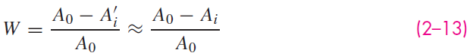
Cold-work Factor
Cold-work factor W – A measure of the quantity of cold work
Fig. 2–6 (b)

Slide 26
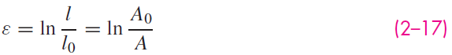
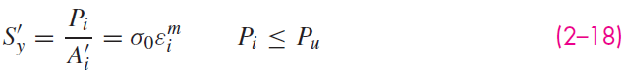
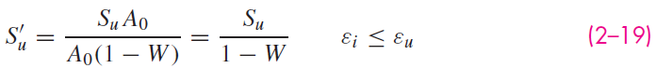
Equations for Cold-worked Strengths

Slide 27
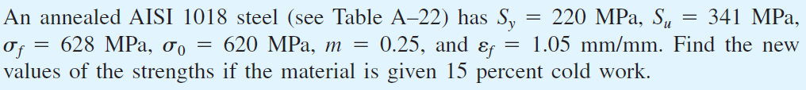
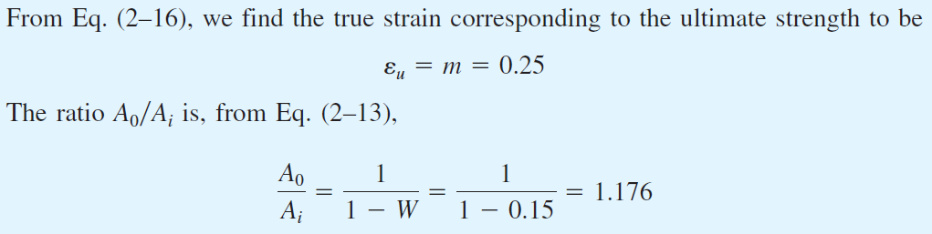
Example 2–2
Solution

Slide 28
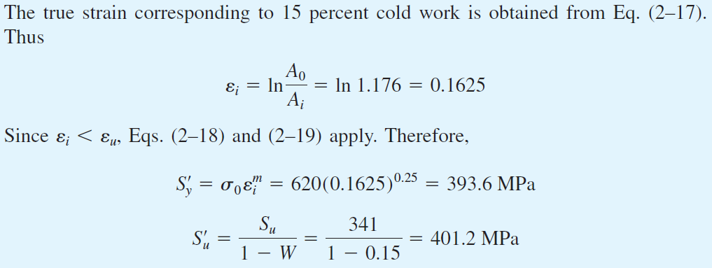
Example 2–2 (Continued)
Answer
Answer

Slide 29
Hardness
Hardness – The resistance of a material to penetration by a pointed tool
Two most common hardness-measuring systems
Rockwell
A, B, and C scales
Specified indenters and loads for each scale
Hardness numbers are relative
Brinell
Hardness number H_{B} is the applied load divided by the spherical surface area of the indentation

Slide 30
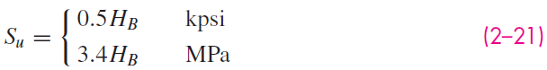
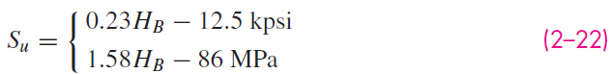
Strength and Hardness
For many materials, relationship between ultimate strength and Brinell hardness number is roughly linear
For steels
For cast iron

Slide 31
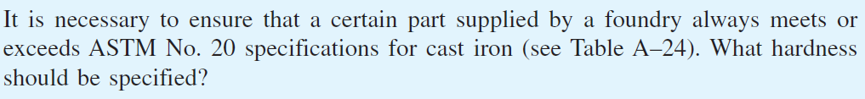
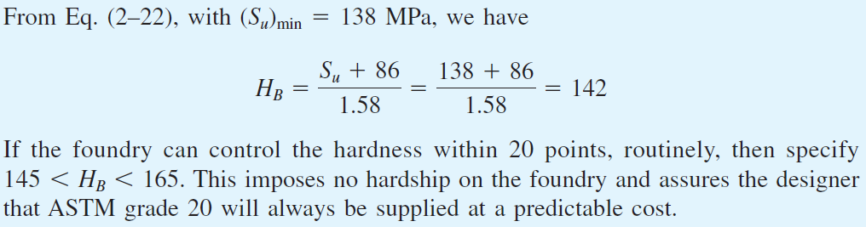
Example 2–3
Solution
Answer

Slide 32
Impact Properties
Charpy notched-bar test used to determine brittleness and impact strength
Specimen struck by pendulum
Energy absorbed, called impact value, is computed from height of swing after fracture

Slide 33
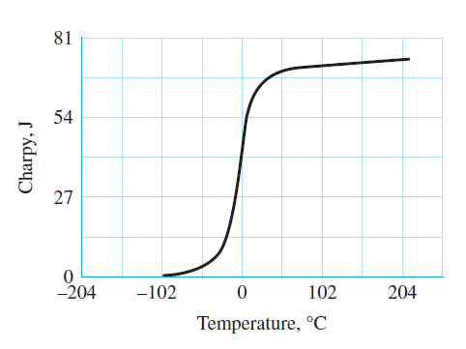
Effect of Temperature on Impact
Some materials experience a sharp transition from ductile to brittle at a certain temperature
Fig. 2–7

Slide 34
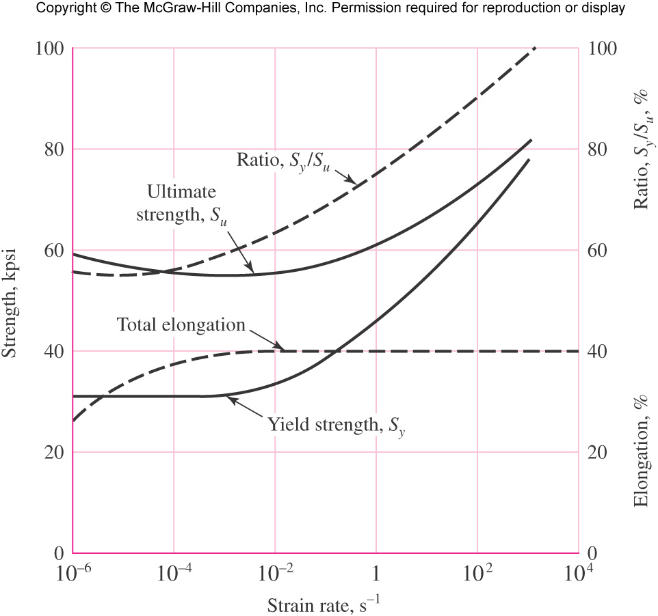
Effect of Strain Rate on Impact
Average strain rate for stress-strain diagram is 0.025 mm/(mm·s)
Increasing strain rate increases strengths
Due to yield strength approaching ultimate strength, a mild steel could be expected to behave elastically through practically its entire strength range under impact conditions
Fig. 2–8

Slide 35
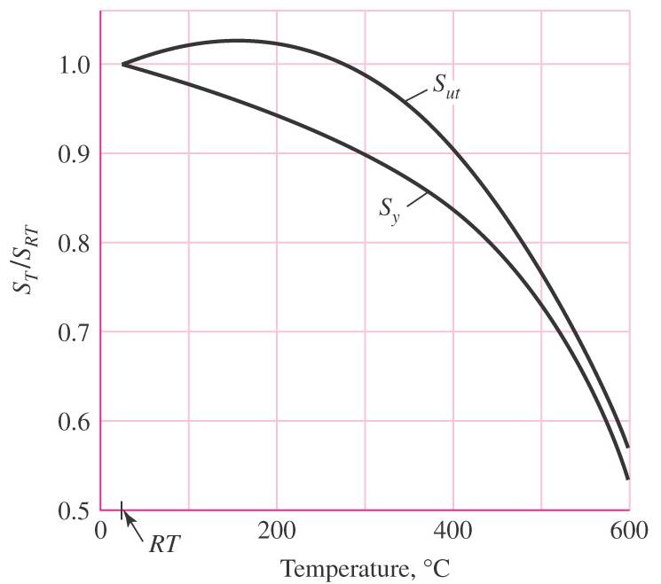
Temperature Effects on Strengths
Plot of strength vs. temperature for carbon and alloy steels
As temperature increases above room temperature
S_{ut} increase slightly, then decreases significantly
S_{y} decreases continuously
Results in increased ductility
Fig. 2–9

Slide 36
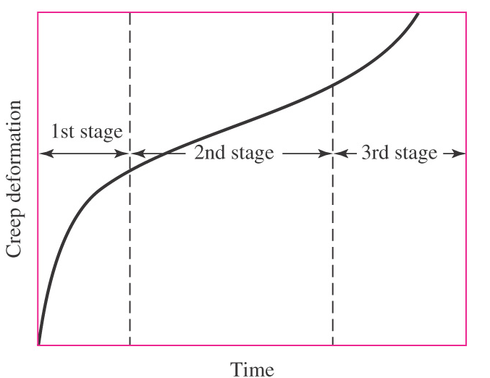
Creep
Creep – a continuous deformation under load for long periods of time at elevated temperatures
Often exhibits three stages
1st stage: elastic and plastic deformation; decreasing creep rate due to strain hardening
2nd stage: constant minimum creep rate caused by the annealing effect
3rd stage: considerable reduction in area; increased true stress; higher creep rate leading to fracture
Fig. 2–10

Slide 37
Material Numbering Systems
Common numbering systems
Society of Automotive Engineers (SAE)
American Iron and Steel Institute (AISI)
Unified Numbering System (UNS)
American Society for Testing and Materials (ASTM) for cast irons

Slide 38
UNS Numbering System
UNS system established by SAE in 1975
Letter prefix followed by 5 digit number
Letter prefix designates material class
G – carbon and alloy steel
A – Aluminum alloy
C – Copper-based alloy
S – Stainless or corrosion-resistant steel

Slide 39
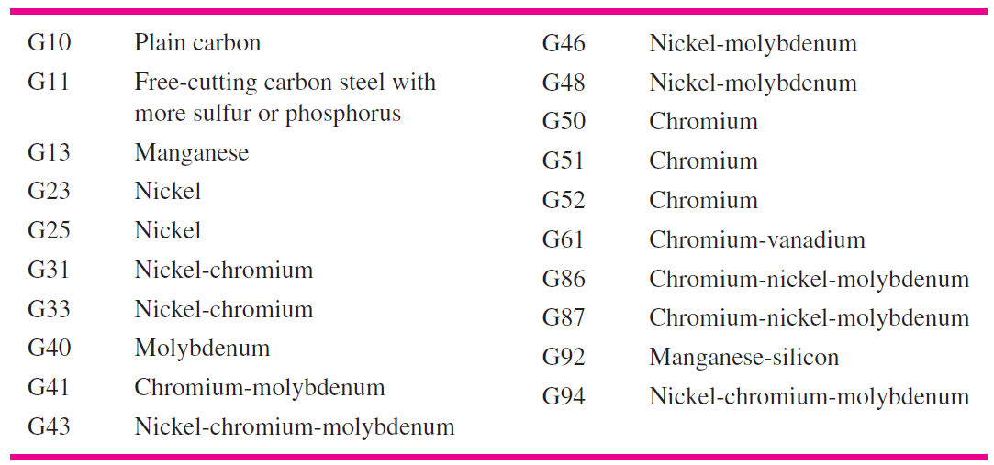
UNS for Steels
For steel, letter prefix is G
First two numbers indicate composition, excluding carbon content
Second pair of numbers indicates carbon content in hundredths of a percent by weight
Fifth number is used for special situations
Example: G52986 is chromium alloy with 0.98% carbon

Slide 40
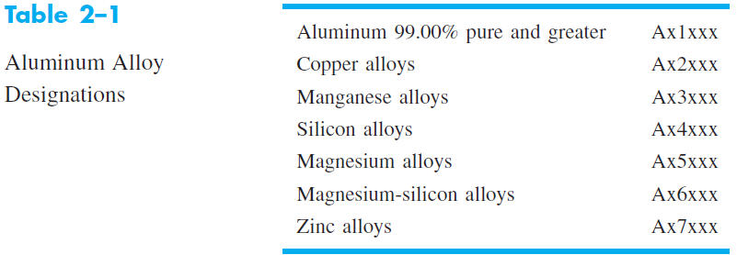
UNS for Aluminums
For aluminums, letter prefix is A
First number indicates processing
Second number indicates the main alloy group
Third number is used to modify the original alloy or to designate the impurity limits
Last two numbers refer to other alloys used with the basic group

Slide 41
Some Casting Processes
Sand Casting
Shell Molding
Investment Casting
Powder-Metallurgy Process

Slide 42
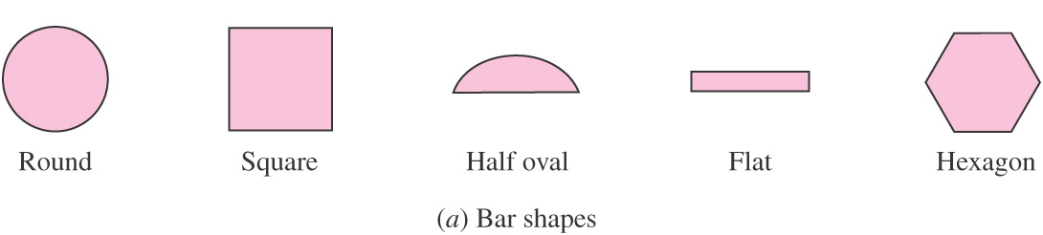
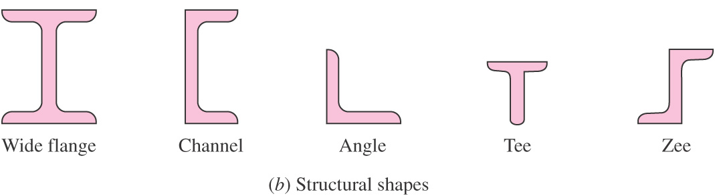
Hot-working Processes
Process in which metal is formed while heated above recrystallization temperature
Refined grain size
Rough surface finish
Rolling, forging, extrusion, pressing
Common bar cross-sections from hot-rolling
Fig. 2–11

Slide 43
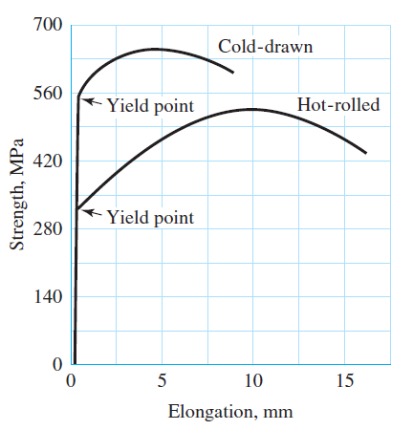
Cold-working Processes
Forming of metal without elevating temperature
Strain hardens, resulting in increase in yield strength
Increases hardness and ultimate strength, decreases ductility
Produces bright, smooth, reasonably accurate finish
Cold-rolling used to produce wide flats and sheets
Cold-drawing draws a hot-rolled bar through a smaller die
Fig. 2–12

Slide 44
Heat Treatment of Steel
Time and temperature controlled processes that modifies material properties
Annealing
Heated above critical temperature, held, then slowly cooled
Refines grain structure, softens, increases ductility
Erases memory of prior operations
Normalizing provides partial annealing by adjusting time and temperature
Quenching
Controlled cooling rate prevents full annealing
Less pearlite, more martensite and/or bainite
Increased strength, hardness, brittleness

Slide 45
Heat Treatment of Steel
Tempering
Reheat after quenching to a temperature below the critical temperature
Relieves internal stresses
Increases ductility, slight reduction in strength and hardness

Slide 46
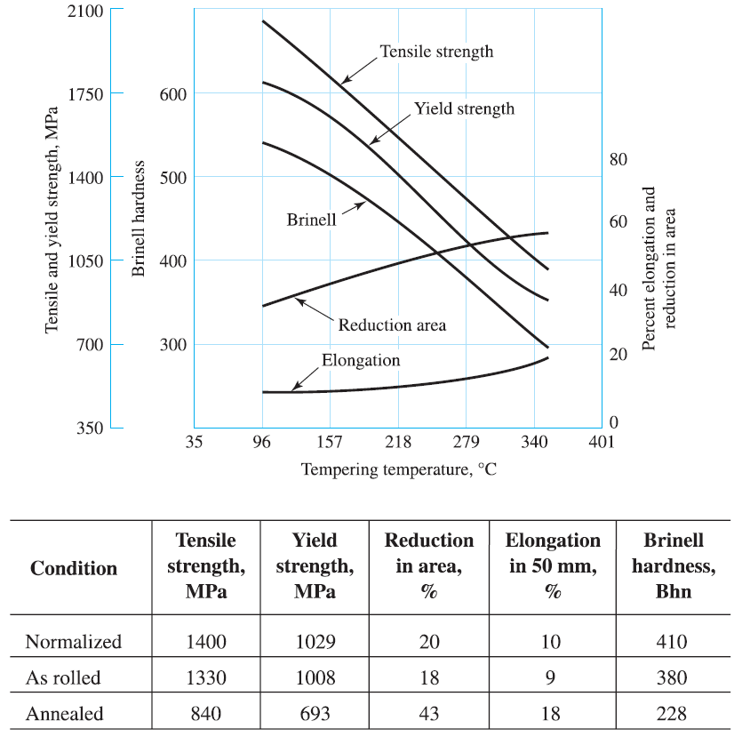
Effects of Heat Treating
Fig. 2–13

Slide 47
Case Hardening
Process to increase hardness on outer surface, while retaining ductility and toughness in the core
Addition of carbon to outer surface by exposure to high carbon solid, liquid, or gas at elevated temperature
Can also achieve case hardening by heat treating only the outer surface, e.g. induction hardening or flame hardening

Slide 48
Alloy Steels
Chromium
Nickel
Manganese
Silicon
Molybdenum
Vanadium
Tungsten

Slide 49
Corrosion-Resistant Steels
Stainless steels
Iron-base alloys with at least 12 % chromium
Resists many corrosive conditions
Four types of stainless steels
Ferritic chromium
Austenitic chromium-nickel
Martensitic
Precipitation-hardenable

Slide 50
Casting Materials
Gray Cast Iron
Ductile and Nodular Cast Iron
White Cast Iron
Malleable Cast Iron
Alloy Cast Iron
Cast Steel

Slide 51
Nonferrous Metals
Aluminum
Magnesium
Titanium
Copper-based alloys
Brass with 5 to 15 percent zinc
Gilding brass, commercial bronze, red brass
Brass with 20 to 36 percent zinc
Low brass, cartridge brass, yellow brass
Low-leaded brass, high-leaded brass (engraver’s brass), free-cutting brass
Admiralty metal
Aluminum brass
Brass with 36 to 40 percent zinc
Muntz metal, naval brass
Bronze
Silcon bronze, phosphor bronze, aluminum bronze, beryllium bronze

Slide 52
Plastics
Thermoplastic – any plastic that flows or is moldable when heat is applied
Thermoset – a plastic for which the polymerization process is finished in a hot molding press where the plastic is liquefied under pressure

Slide 53

Thermoplastic Properties (Table 2–2)

Slide 54

Thermoset Properties (Table 2–3)

Slide 55

Composite Materials
Formed from two or more dissimilar materials, each of which contributes to the final properties
Materials remain distinct from each other at the macroscopic level
Usually amorphous and non-isotropic
Often consists of laminates of filler to provide stiffness and strength and a matrix to hold the material together
Common filler types:
Fig. 2–14

Slide 56

Material Families and Classes (Table 2–4)

Slide 57

Material Families and Classes (Table 2–4)

Slide 58

Material Families and Classes (Table 2–4)

Slide 59

Material Families and Classes (Table 2–4)

Slide 60

Young’s Modulus for Various Materials
Fig. 2–15

Slide 61

Young’s Modulus vs. Density
Fig. 2–16

Slide 62
Specific Modulus
Specific Modulus – ratio of Young’s modulus to density, E / ρ
Also called specific stiffness
Useful to minimize weight with primary design limitation of deflection, stiffness, or natural frequency
Parallel lines representing different values of E / ρ allow comparison of specific modulus between materials
Fig. 2–16

Slide 63
Minimum Mass Guidelines for Young’s Modulus-Density Plot
Guidelines plot constant values of E^{β}/ρ
β depends on type of loading
β = 1 for axial
β = 1/2 for bending
Example, for axial loading,
k = AE/l ⇒ A = kl/E
m = Alρ = (kl/E) lρ =kl² ρ /E
Thus, to minimize mass, maximize E/ρ (β = 1)
Fig. 2–16

Slide 64

The Performance Metric
The performance metric depends on (1) the functional requirements, (2) the geometry, and (3) the material properties.
The function is often separable,
f₃ (M) is called the material efficiency coefficient.
Maximizing or minimizing f₃ (M) allows the material choice to be used to optimize P.

Slide 65

Performance Metric Example
Requirements: light, stiff, end-loaded cantilever beam with circular cross section
Mass m of the beam is chosen as the performance metric to minimize
Stiffness is functional requirement
Stiffness is related to material and geometry

Slide 66



Performance Metric Example
From beam deflection table,
Sub Eq. (2-26) into Eq. (2-25) and solve for A
The performance metric is
Sub Eq. (2–27) into Eq. (2–28),

Slide 67




Performance Metric Example
Separating into the form of Eq. (2–24),
To minimize m, need to minimize f₃ (M), or maximize

Slide 68

Performance Metric Example
M is called material index
For this example, β = ½
Use guidelines parallel to E^{1/2}/ρ
Increasing M, move up and to the left
Good candidates for this example are certain woods, composites, and ceramics
Fig. 2–17

Slide 69

Performance Metric Example
Additional constraints can be added as needed
For example, if it is desired that E > 50 GPa, add horizontal line to limit the solution space
Wood is eliminated as a viable option
Fig. 2–18

Slide 70

Strength vs. Density
Fig. 2–19

Slide 71
Specific Modulus
Specific Strength – ratio of strength to density, S / ρ
Useful to minimize weight with primary design limitation of strength
Parallel lines representing different values of S / ρ allow comparison of specific strength between materials
Fig. 2–19

Slide 72
Minimum Mass Guidelines for Strength-Density Plot
Guidelines plot constant values of S^{β}/ρ
β depends on type of loading
β = 1 for axial
β = 2/3 for bending
Example, for axial loading,
σ = F/A = S ⇒ A = F/S
m = Alρ = (F/S) lρ
Thus, to minimize m, maximize S/ρ (β = 1)
Fig. 2–19

